Slide 1
World History Dataverse Data Mining Challenges and Opportunities
Carlos A. Sánchez
03/19/2012

Slide 2
Agenda
What is Data Mining and what it has to do with the World-History Dataverse?
Side show?
Afterthought?
Should we forget about it?
Which are the main high level challenges and where are we going to find them?
As opposed to laundry list of technical challenges
Spoiler alert: Do we want to pave the cow path?

Slide 3
What is Data Mining DM?
DM: Extraction of interesting (non-trivial, implicit, previously unknown and potentially useful) patterns or knowledge from huge amount of data
Goals: Descriptive, Predictive and/or Prescriptive

Slide 4
Cross-Industry Process for Data Mining CRISP-DM 1.0
Initially funded by the European Strategic Program on Research in Information Technology (ESPRIT) – Released in 1999
Consortium Led by
Daimler-Benz
NCR → Teradata
SPSS
OHRA

Slide 5
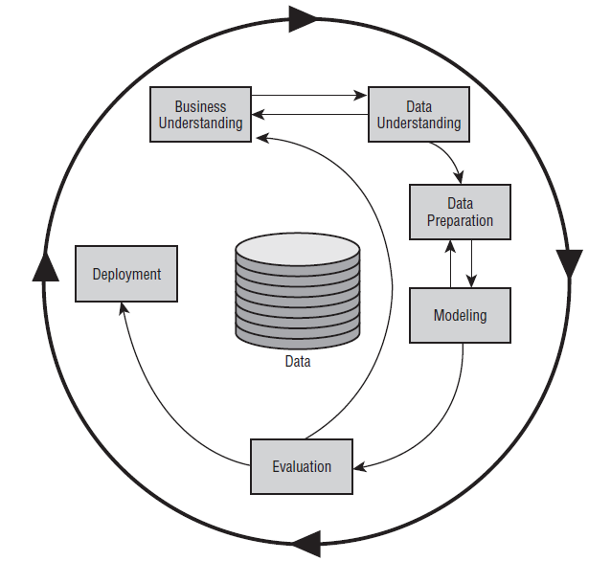
CRISP-DM & World-History Dataverse
Multiple Domains Understanding and Collaboration: Goals?
Acquisition, Verification and Understanding of Multiple Data sets from diverse domains
Multiple Data Sets with diverse standards & levels of quality
Cleaning, Documentation, Enhancing, Transformation, Archival
Loosely Coupled Models: What-if. Let individual Models talk
Implementation & Monitoring: Multiple goals, users and audiences. Visualization
Results vs. Goals & Known Outcomes

Slide 6
Modeling Challenges

Slide 7
Modeling Challenges

Slide 8
Modeling Challenges

Slide 9
Modeling Challenges

Slide 10
Modeling Challenges

Slide 11
References 1
A Visual Guide to the CRISP-DM Methodology, http://www.ddialliance.org/sites/default/files/crisp_visualguide.pdf
Bernstein P. and Melnik S. (2007). Model Management 2.0: Manipulating Richer Mappings. In Proceedings of the ACM SIGMOD International Conference on Management of Data (SIGMOD), pages 1–12.
Chapman Pete, Clinton Julian, et. al.(2000), CRISP-DM 1.0 Process and User Guide, http://www.crisp-dm.org/CRISPWP-0800.pdf
Data Mining Research Group: http://dm1.cs.uiuc.edu/projects.html
Haas Peter J., Maglio Paul P., Selinger Patricia G., Tan Wang-Chiew. (2011). Data is Dead Without What-If Models. In Proceedings of Very Large Data Bases Endowment, PVLDB 2011.
Haas L.M., Hernández M.A., Ho H., Popa L., and Roth M. (2005). Clio Grows Up: From Research Prototype to Industrial Tool. SIGMOD 2005: 805-810
Malerba, Donato, Ceci, Michelangelo, Appice, Annalisa, Kryszkiewicz, Marzena, Rybinski, Henryk, Skowron, Andrzej, Ras, Zbigniew. (2011). Relational Mining in Spatial Domains: Accomplishments and Challenges, Book Title: Foundations of Intelligent Systems. Lecture Notes in Computer Science, Springer Berlin / Heidelberg. ISBN: 978-3-642-21915-3 . ol 6804, pp. 16-24

Slide 12
References 2
Hillol Kargupta, Jiawei Han, Philip Yu, Rajeev Motwani, and Vipin Kumar (eds.), Next Generation of Data Mining (Chapman & Hall/CRC Data Mining and Knowledge Discovery Series), Taylor & Francis, 2008.
Piatetsky-Shapiro Gregory, Djeraba Chabane, Getoor Lise, Grossman Robert, Feldman Ronen, and Zaki Mohammed. (2006). What are the grand challenges for data mining?: KDD-2006 panel report. SIGKDD Explor. Newsl. 8, 2 (December 2006), 70-77. DOI=10.1145/1233321.1233330 http://doi.acm.org/10.1145/1233321.1233330
Shvaiko, Pavel, Euzenat, Jérôme. (2008).Ten Challenges for Ontology Matching. On the Move to Meaning Ful Internet Systems: OTM 2008, eds. Zahir T., Meersman, R., Springer Berlin / Heidelberg, ISBN: 978-3-540-88872-7, Lecture Notes in Computer Science, Vol. 5332, pp. 1164-1182
SPLASH: http://www.almaden.ibm.com/asr/projects/splash/
University of Pittsburgh Public Health Dynamics Laboratory: https://www.phdl.pitt.edu/

Slide 13
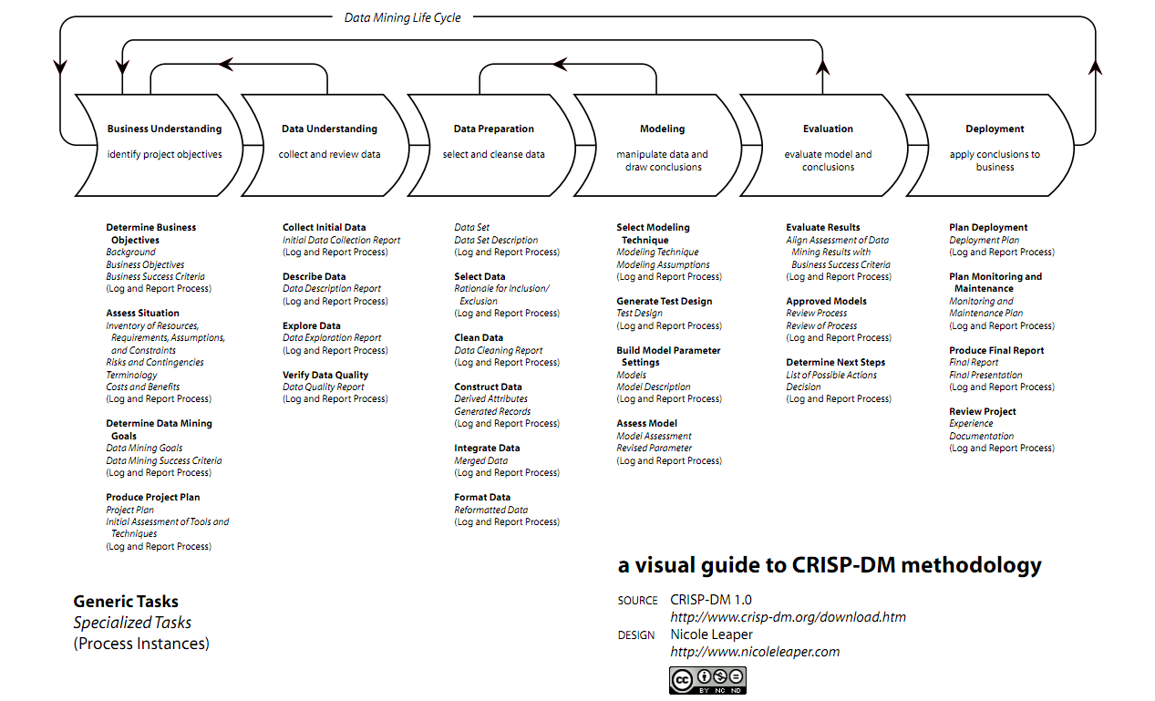
Notes:
There are tons of details in every step………………..don’t worry, I am not going to discuss the today.

Slide 14
Standards and Systems that will Support Loosely Connected Models
Data Documentation Initiative (DDI) < http://www.ddialliance.org/what >
Historical Event Markup and Linking Project (Heml) < http://heml.org/ >
Geographic Markup Language (GML) < http://www.opengeospatial.org/
Geologic Markup Language (GeoSciML) < http://www.geosciml.org/ >
Predictive Model Markup Language (PMML) < www.dmg.org >
Scalable Vector Graphics (SVG) < http://www.w3.org/Graphics/SVG/ >
Javascript Object Notation (JSON) < http://www.json.org/ >
YAML Ain't Markup Language (YAML)< http://yaml.org/ >
CLIO: Schema Mapping Management System < http://www.almaden.ibm.com/cs/projects/criollo/ >

